Slide 1
Analytical Hierarchy Process (AHP) Tool
Dandi Baskoro Soebakir

Slide 2
Analytical Hierarchy Process (AHP)
Start
Define Goals
Hierarchical Model
The AHP method is a decision-making method used to select or determine the best alternative from several available options based on multiple criteria (Saaty, 1980).
AHP involves structuring a decision problem into a hierarchical model, consisting of: the main goal (top level), criteria and sub-criteria (middle level), and alternatives (bottom level).
Decision makers provide pairwise comparisons between criteria or alternatives to assess their relative importance.
Pairwise Comparison Matrix (1-5 Scale Saaty)
Weighed and Eigen value
Scales of Relative Importance (modified from Saaty, 1980)
Consistency Test ? (<10%)
Intensity of importance | Definition
1 | Equally importance
2 | Weak importance of one over another
3 | Essential or strong importance
4 | Demonstrated importance
5 | Absolute importance
Reciprocal of above nonzero | If activity i has one of the above nonzero numbers assigned to it when compared with activity j, then j has the reciprocal value when compared with i
No
Yes
Global Weighted
Best Alternative
Stop

Slide 3
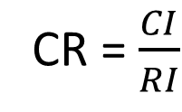
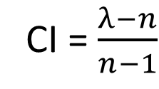
Consistency Test
The Consistency Ratio (CR) measures the stability and logic of the decision maker’s thought process (Selamat, 2002).
Low CR (<0.1) -> rational and logically coherent.
High CR (>0.1) -> contradictions or bias.
CI = $\frac{λ−n}{n−1}$
CR = $\frac{CI}{RI}$
dimana,
CR : Consistency ratio
CI : Consistency index
λ : Eigen value
n : Number of criteria

Slide 4
Advantages
Flexible and adaptable.
Structured and logical decision-making process.
Incorporates expert judgement.
Provide ranking and priorite based result.
Limitation
High subjectivity of Judgements.
Difficulty in maintaining consistency.
Inability to handle uncertainty.
High sensitivity to weight changes.

Slide 5
Application
Geothermal and petroleum exploration.
Engineering design and project prioritization.
Environmental and land use planning.
Etc.

Slide 6
Reference
Saaty, T. L. 1980. The Analytic Hierarchy Process: Planning, Priority Setting, Resource Allocation. New York: McGraw-Hill.
Saaty, T. L. 1987. The Analytic Hierarchy Process-What It Is And How It Is Used. Pergamon Journals Ltd, 9, 3-5.
Vargas, L. G. 1990. An Overview Of The Analytic Hierarchy Process And Its Application. European Journal of Operational Research, 48(1), 2-8.
Selamat, M. B. 2002. Pembobotan Parameter Dan Penentuan Keputusan. Modul Praktikum Sistem Informasi Geografis. Ilmu Kelautan.

Slide 7
Case Study: CAN

Slide 8
Geology Overview

Slide 9
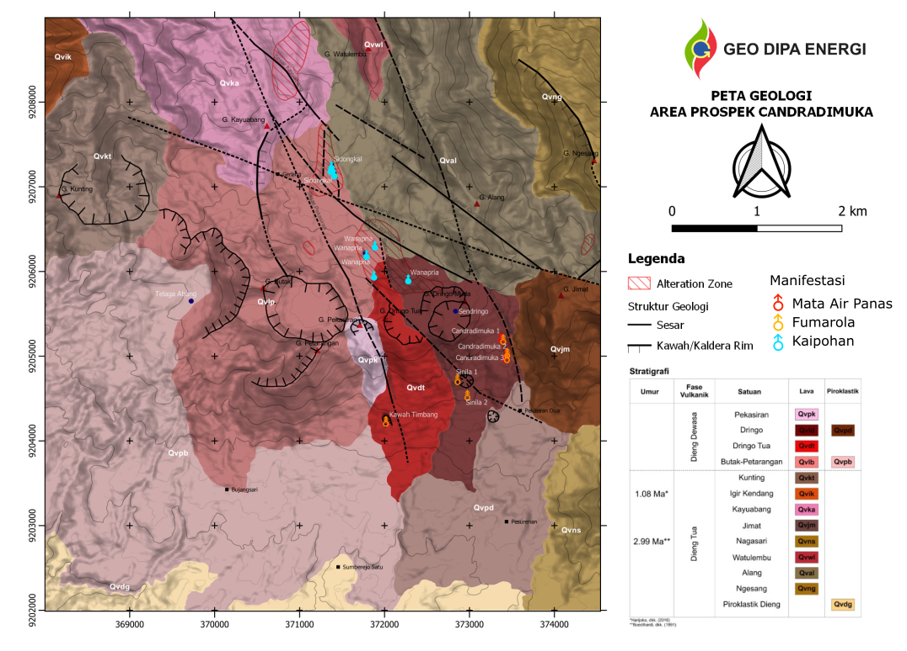
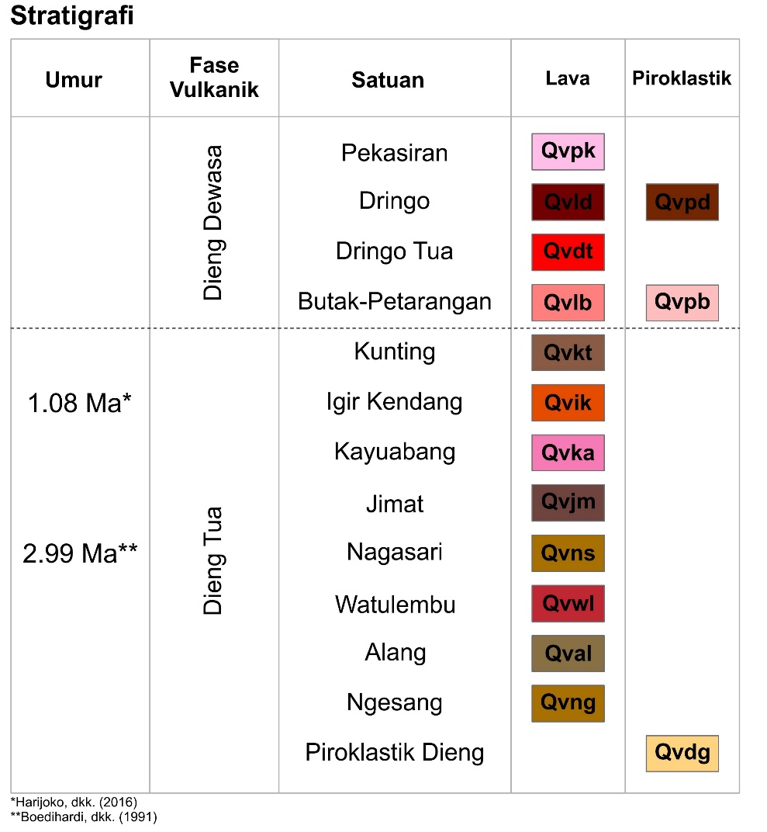
Geology of Candradimuka
(UGM, 2018)
Notes:
Cerita umur

Slide 10
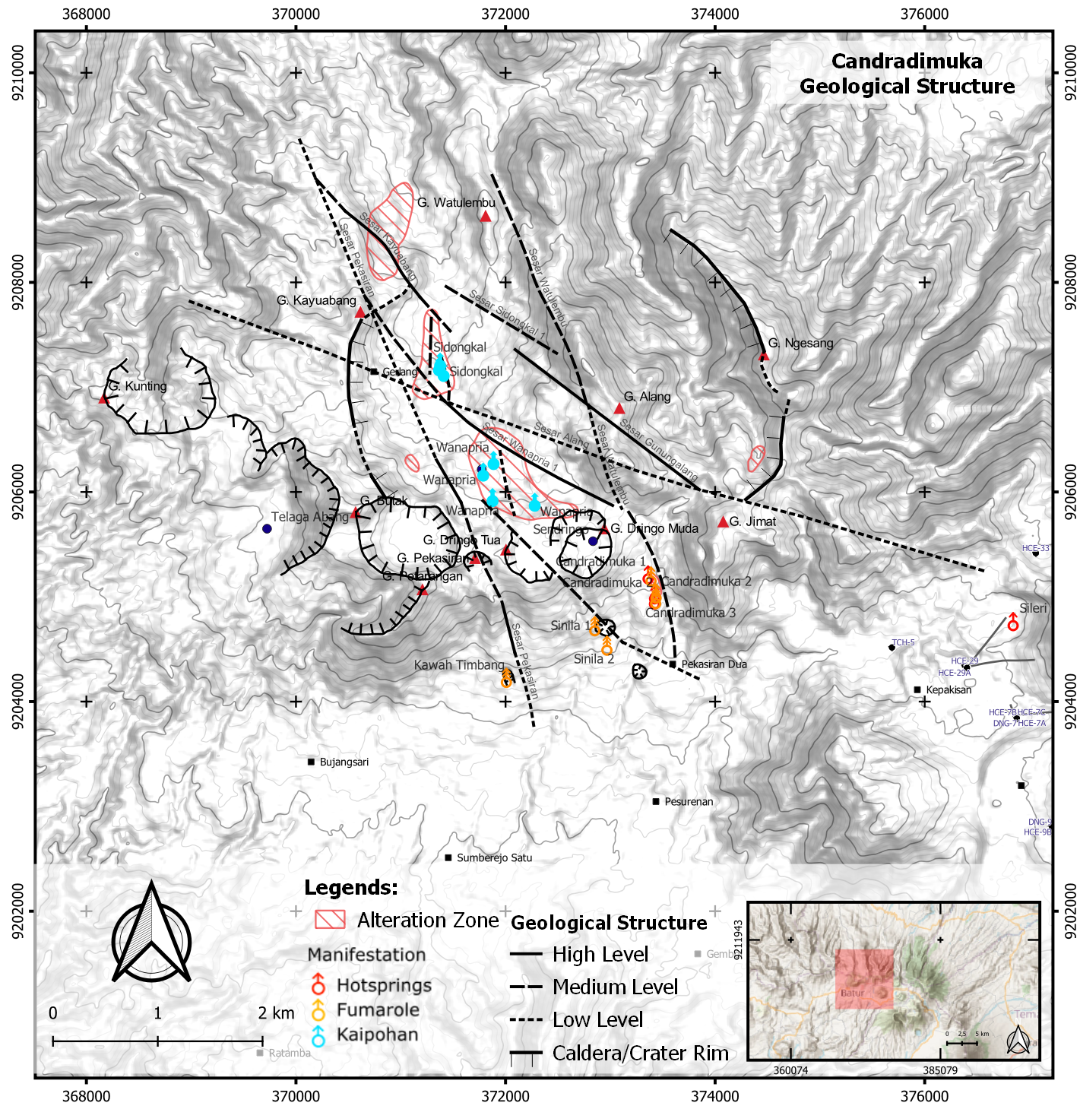


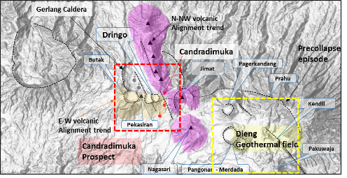
Geology Structure of Candradimuka
The surface manifestation of Candradimuka prospect is situated in the pre-caldera collapse (Gerlang Caldera) and Butak – Dringo –Pekasiran volcanism.
The Candradimuka geothermal system is might be associated with the NNW structure and the old caldera feature.
Geological structure was observed through DEMNAS (8m resolution) and cross checked by field checking (UGM, 2018). The structures are classified as (see details in the next slide)s:
High level conf. struct: proved by field check and strong lineament.
Medium level conf. struct: found several fractures that may relates to the closest fault, lineament, volc lineament, thermal manifestation existence, alteration zone.
Low level conf. struct: lineament (some weak), thermal manifestation existence.
The main structure in Candradimuka is the NNW-SSE and NW-SE faults which potentially act as permeability that might controls the existence of Candradimuka fumarole, Sinila, and kaipohan in Wanapria and Sidongkal.
The existence of Candradimuka fumarole which located outside the Gerlang Caldera, and existence of kaipohan inside the caldera may indicates the permeability seems to be located in the intersection zone of Gerlang Caldera and the NNW structure.
Therefore, in terms of well targeting these feature is highly need to be considered.
Actively High CO2 gas zone release

Slide 11
Geology Structure of Candradimuka – Structure Classification

Slide 12
Geochemistry Overview

Slide 13
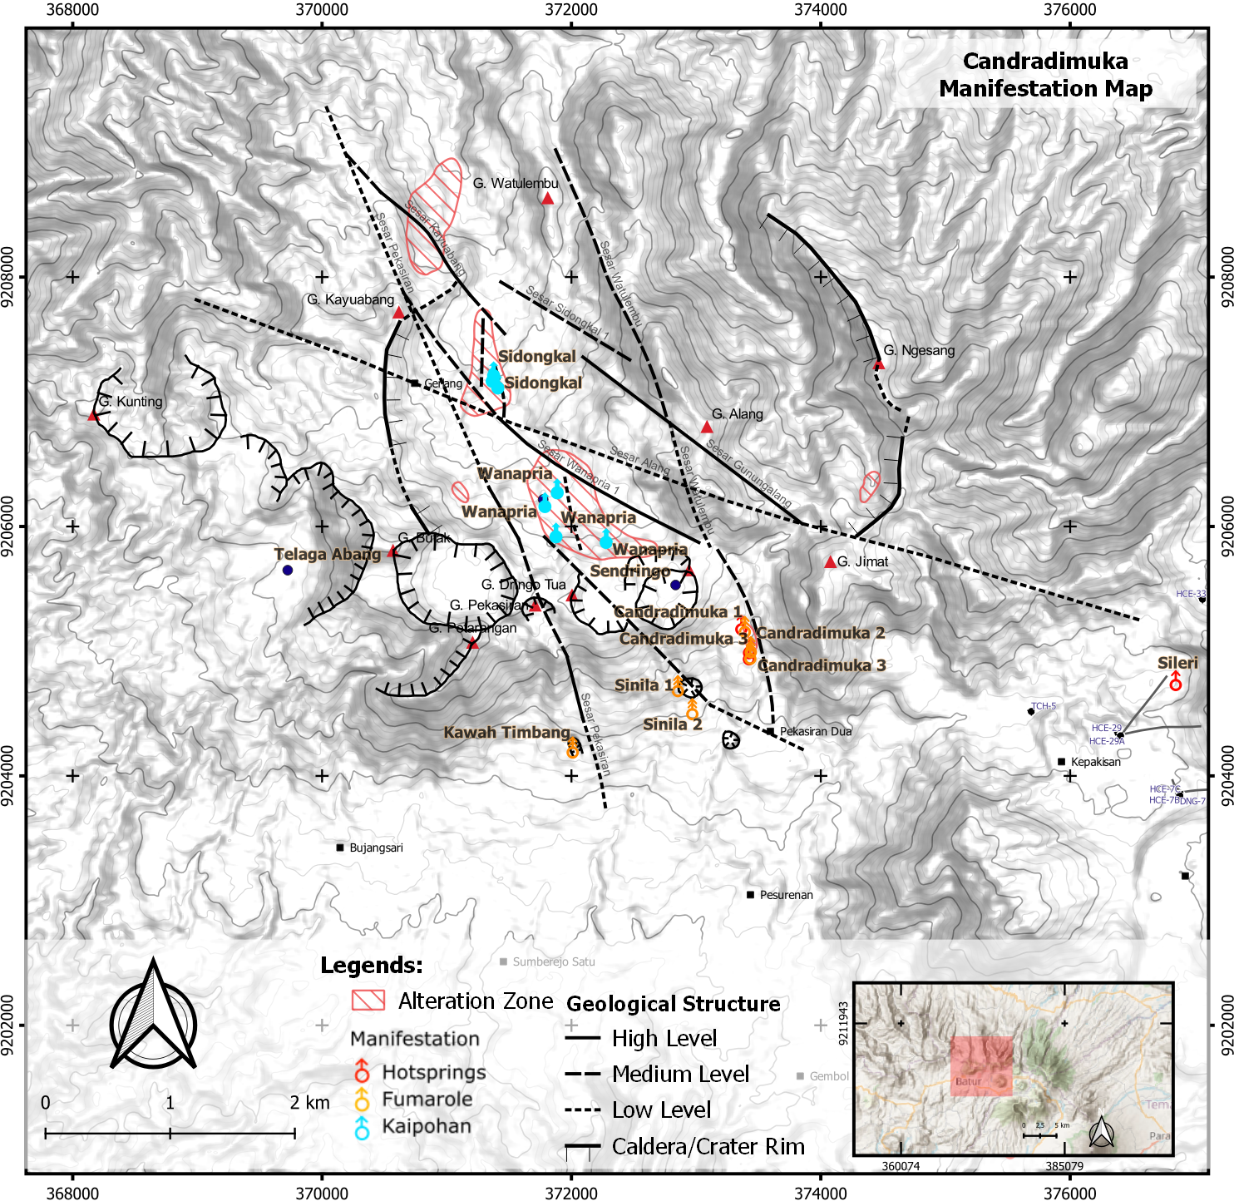
Geochemical Signature
Several thermal and non-thermal manifestations are found in Candradimuka Prospect, such as Hot springs, Fumarole, Cold Springs, Kaipohan and Hg soil gas anomalies.
Fumaroles of Candradimuka (GC1,2,3) area are 90-92°C with high NCG content (16-37wt%) and represent the reservoir condition. Possibly controlled by NW-SE fault.
Dataset of samples were recorded in:
Sidongkal
Kaipohan
T: 20.7°C
Wanapria
Kaipohan
T: 18.1°C
Candradimuka
1, 2 & 3
Hot Springs – SO₄
T 70 - 92.4 °C
pH 5.75 - 6.8
Cl: 2.35 - 3.99 mg/L
SO₄: 90.7 - 145 mg/L
HCO₃: 54 - 72,7 mg/L
Flowrate: 1 - 2 L/s
No | Publication Title | Data
1. | Report of Surface Survey Results in Candradimuka (JICA, 2016) Two sample sets. Resample of gas manifestation required due to error in sample preparation. | Liquid, Gas, Isotope (¹⁸O, ²H, and ¹³C), Soil Gas (Hg and CO₂)
2. | TA-7583 INO: Geothermal Power Development Project. Geothermal potential of Mangunan and Candradimuka, Dieng WKP (ADB, 2014) | Liquid and Gas
3. | Penyelidikan Merkuri, Gas Tanah Karbon Dioksida, dan Suhu Udara Tanah, Serta Alterasi Permukaan Untuk Mengetahui Persebaran Zona Panas di Kawasan Kawah Candradimuka dan Sekitarnya, Kecamatan Batur, Kabupaten Banjarnegara (Payana and Harijoko, 2016) | Soil Gas (Hg and CO₂)
4. | Memahami Gas Gunung Api (Priatna and Primulyana, 2021). | Gas
Telaga
Cold Spring – SO₄
T 18.7 °C
pH 5.61
Cl: 0.35 mg/L
SO₄: 69.53 mg/L
HCO₃: 7.36 mg/L
Flowrate: 10 L/s
Wanapria
Cold Spring – SO₄
T 18.7 °C
pH 4.62
Cl: 2.62 mg/L
SO₄: 26 mg/L
HCO₃: 0 mg/L
Flowrate: 2-3 L/s
Candradimuka
1, 2 & 3
Fumarole
T: 92 – 92.72°C
Timbang
Gas Vent
T: 60-65°C
Sinila 1&2
Fumarole
T: 73.5 - 83.2°C
Notes:
Gas samples acquired in early 2016 by JICA is resampled on mid 2016 due to sample preparation error (JICA, 2016). The composition of CH4 is deemed too high on all samples. Therefore, there are no data available for Wanapria and Sidongkal areas.
Hot springs of Candradimuka area and cold spring of Wanapria are SO₄- type and indicating steam-heated surface features based on Cl-SO₄-HCO₃ diagram and Cl vs. B plot.

Slide 14
Geochemistry Summary
Association | Manifestations Area | Manifestation Type | Key Information | Conceptual Model | Temp (°C) |  |  | Risk
 |  |  |  |  | LC | BC | HC
Phreatic Eruption Vents | Candradimuka | Fumaroles and Hot Spring | Most prominent high temperature features (90-92°C). Hot springs are steam-heated and conductively-heated waters. The isotope is enriched by water-rock interaction. Fumaroles is very active and has high NCG (4.70-19.90 %mol). Fumarole data shows tendency of magmatic gas source (high NCG, high SO₂ and H₂S). HAr-CAr grid indicates two phase fluid with 230-275°C. | May indicate vertical flow associated to or close to the upflow zone. Higher risk of magmatic input than Wanapria and Sidongkal. | 230 | 250 | 275 | High volume of magmatic gas input in the reservoir. Less likely corrosive and abrasive fluid. Hydrothermal Eruption due to pressure unloading while drilling. High volume gas discharge near to residential area.
 | Sinila | Hot Gas Discharge | Gas discharge is very active (73.5°C) and has high NCG (49.80%mol). Fumarole data shows strong tendency of magmatic gas source (very high NCG, higher H₂S content than Candradimuka). Slight tendency of sedimentary rock presence (CH₄ gas). Erupted in 1979 and discharged hot mud and lahar. | May indicate vertical flow associated to or close to the upflow zone. Higher risk of magmatic input than Wanapria and Sidongkal. | Wide Temp Range (not reliable)
 | Timbang | High Volume Hot Gas Discharge. | Gas discharge is very active (60-65°C). PSDG declared that Timbang Crater is has more gas discharge than Sinila Crater. No gas sample is available. Frequent earthquake sourced from this crater occurred last in 2019. | Located close to margin of system (due to no data available). Higher risk of magmatic input than Wanapria and Sidongkal. | No Data Available
Kaipohan | Wanapria | Kaipohan and Cold Springs. | Cold Spring is acidic (3-5) and indicating steam-heated water with magmatic input. Kaipohan has a number of faint gas vents, but the data is not reliable. | May indicate the edge of the system. May have deeper reservoir with high temperature. Lower risk of magmatic input than Candradimuka, Sinila and Timbang. |  |  |  | Low permeability reservoir. Less active geothermal activity.
 | Sidongkal | Kaipohan and Cold springs. | Suspected as inactive eruption vents. Active cold gas vents, high H₂S (up to 371 ppm on gas detector field measurement). No gas data available.

Slide 15
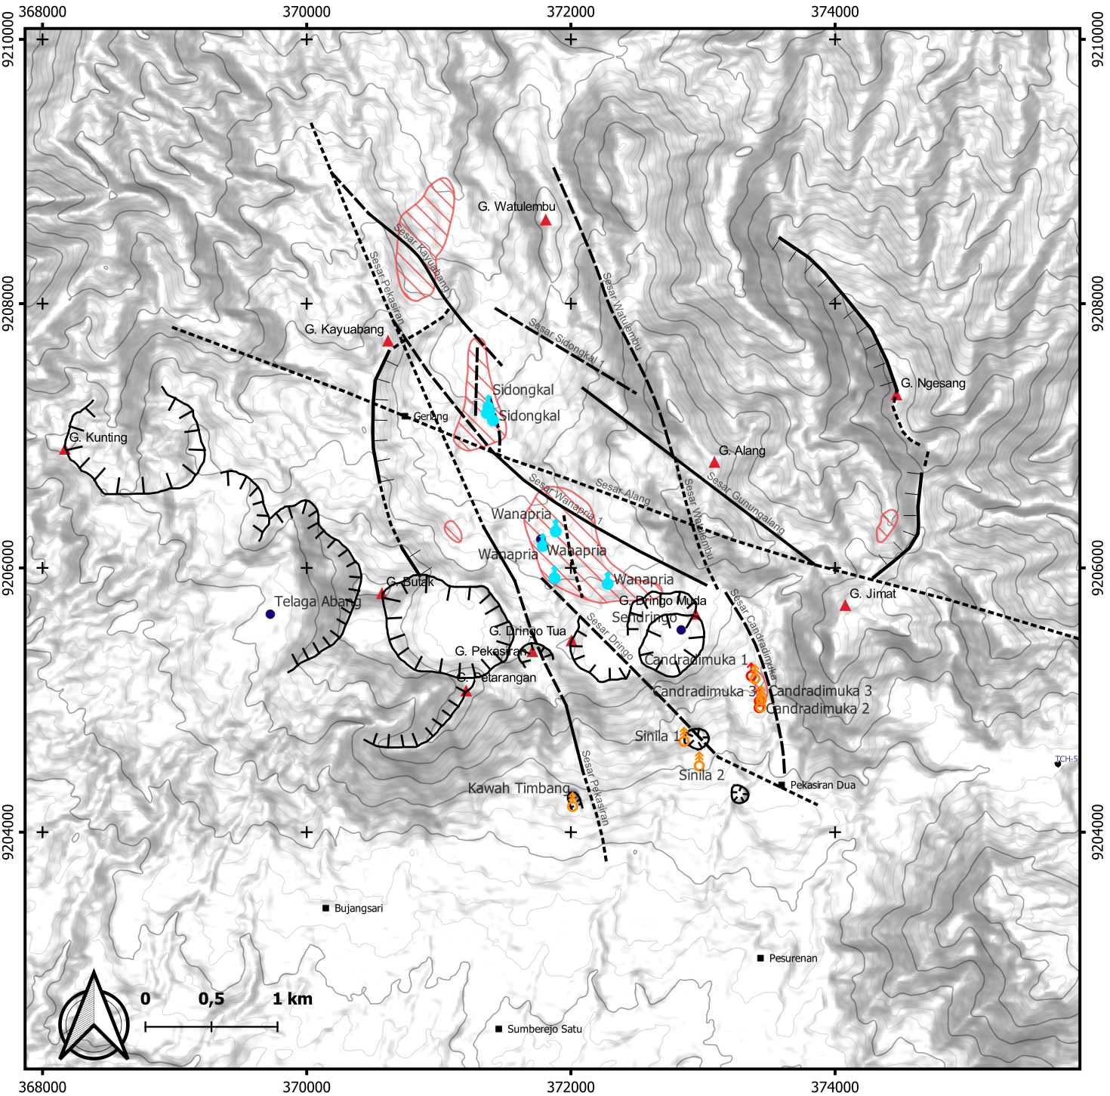
Geochemical Model and Fluid Pathway
Key Geochemistry Features:
There are several thermal and non-thermal manifestations found in Candradimuka Prospect. There are: Hot springs, Fumarole, Cold Springs, Kaipohan and Hg soil gas anomalies.
Hot springs of Candradimuka area and cold spring of Wanapria are SO₄⁻ type and indicating steam-heated surface features based on Cl-SO₄-HCO₃ diagram and Cl vs. B plot.
Fumaroles of Candradimuka area are 90-92°C with high NCG content (16-37wt%). Possibly controlled by NW-SE fault.
The presence Candradimuka fumarole and Wanapria Kaipohan imply the upflow area of the geothermal system.
However, the fumaroles are also present as the edge of the upflow that is sourced from the reservoir.
The kaipohan may occurs due to some gas leak beneath the up-flow area.
Estimated reservoir temperature based on gas geothermometers is ~ 230° - 275 ° C.
Estimated to have two-phase liquid and circumneutral pH, however, may indicated to be located at deeper elevation.
Outflow
Upflow
Outflow ?

Slide 16
Geophysical Overview

Slide 17
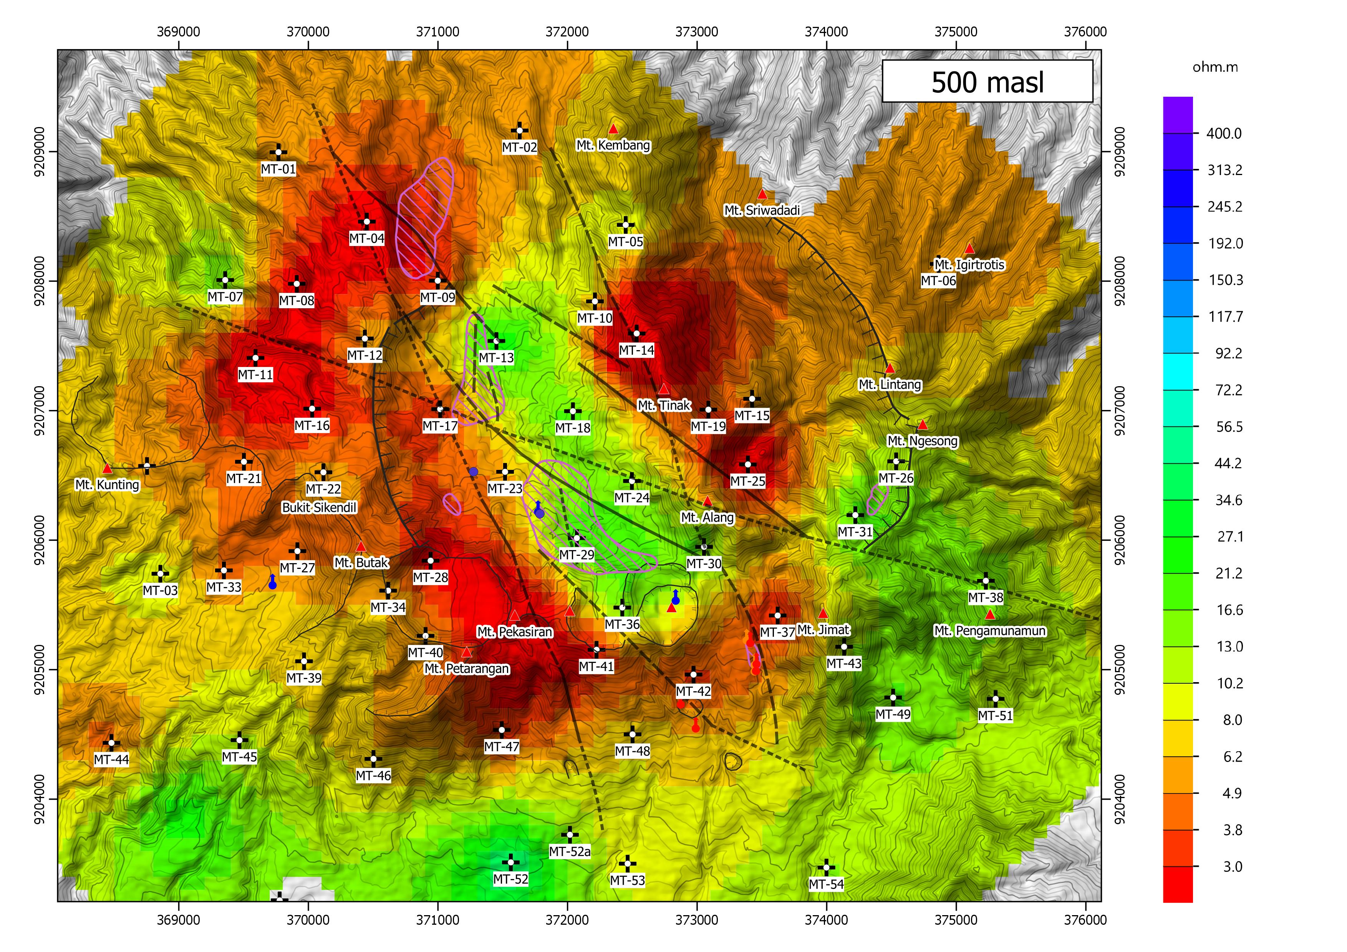
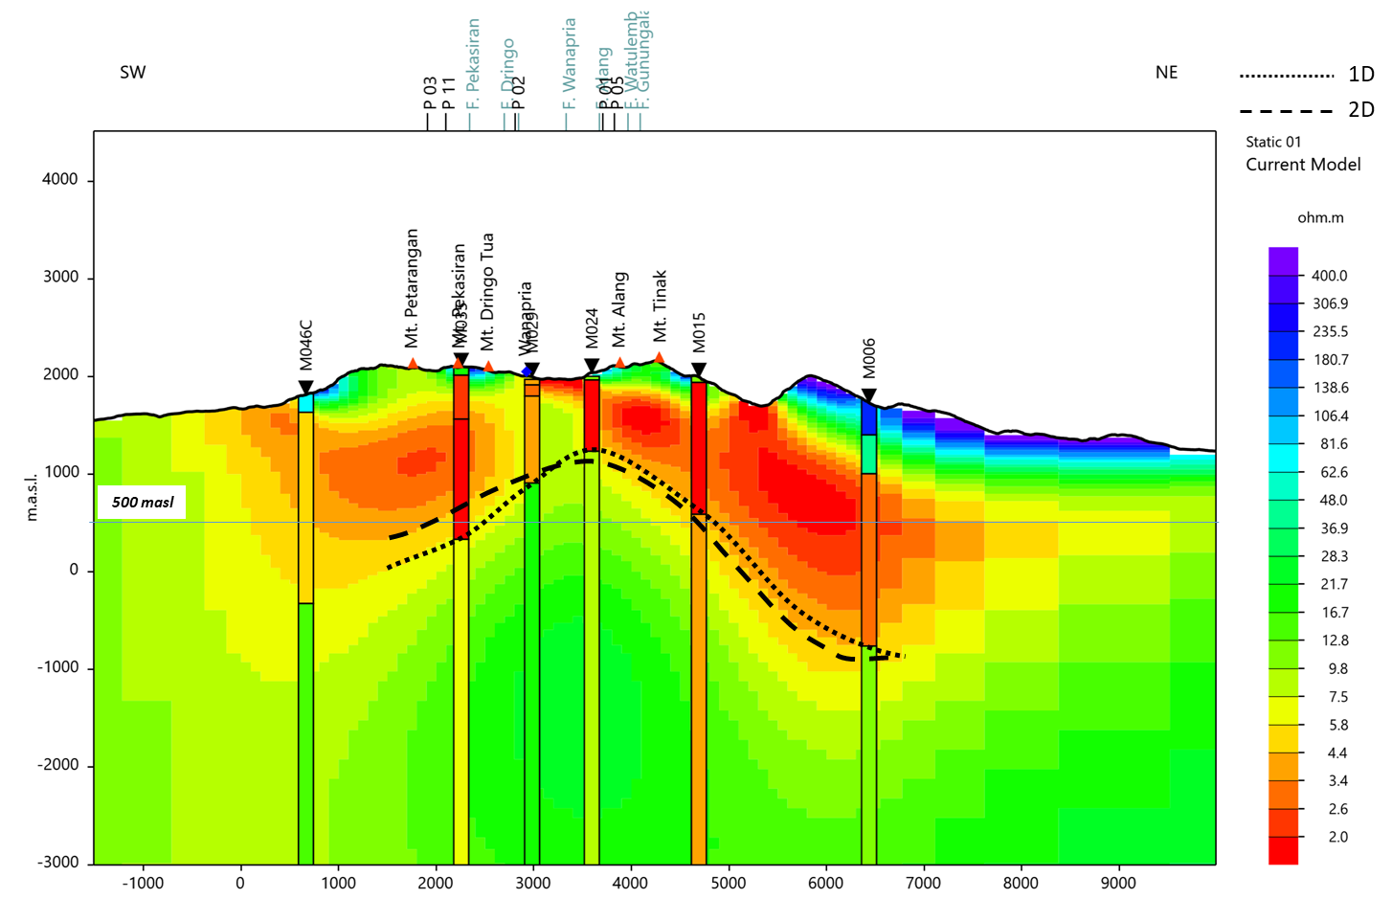
MT Inversion, GDE 2022
MT station distribution limitation
South-Southeast: Did not cover fumarole Candradimuka area
East: Sparse MT station, …
The conductive doming shows a typical for mature geothermal system
Shows doming of conductive layer above resistive core which centered beneath the Gerlang area,
Resistivity map at 500 masl shows close conductive body that may represent most likely areal extent of high temp system which outlining outflow
Resource delineation
P90: Has doming feature, near youngest volcanic
P50: Edge of flattening feature before thickening, located beneath the Kaipohan and fumarol Candradimuka
P10: The edge of thickening conductive and cover fumarole Candradimuka
Resource Area
Min
NW
Most
Max
NE
sparse
MT Station
No
MT Station
SW
SE
NW
SE
SW
NE

Slide 18
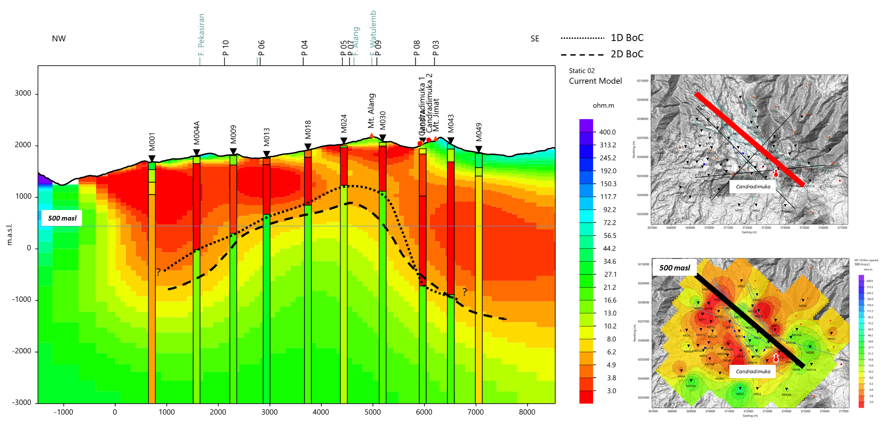
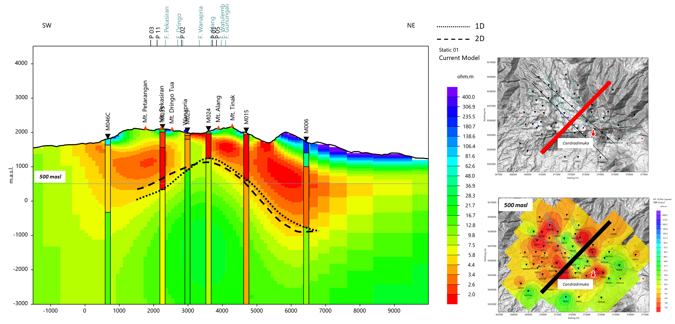
MT Cross-section
Shows doming of conductive layer above resistive core which centered beneath the Gerlang area, typical for mature geothermal system
The elongated conductive doming body is in the direction of NW-SE (~4.5 km long)
Meanwhile, in direction NE-SW, conductive doming body is very narrow (~1.5 km wide)
BoC is based on 6Ωm.
1D BoC will be used to define BoC depth. Meanwhile 2D MT BoC seems suggested the lateral variation of conductive layer
1D BoC elevation is founded at the range elevation of 1000 to -1000 masl (dotted line on cross-section)
Candradimuka fumarole is located at the edge of thickening conductive area
Kaipohan Wanapria is located close to doming feature while Sidongkal is further

Slide 19
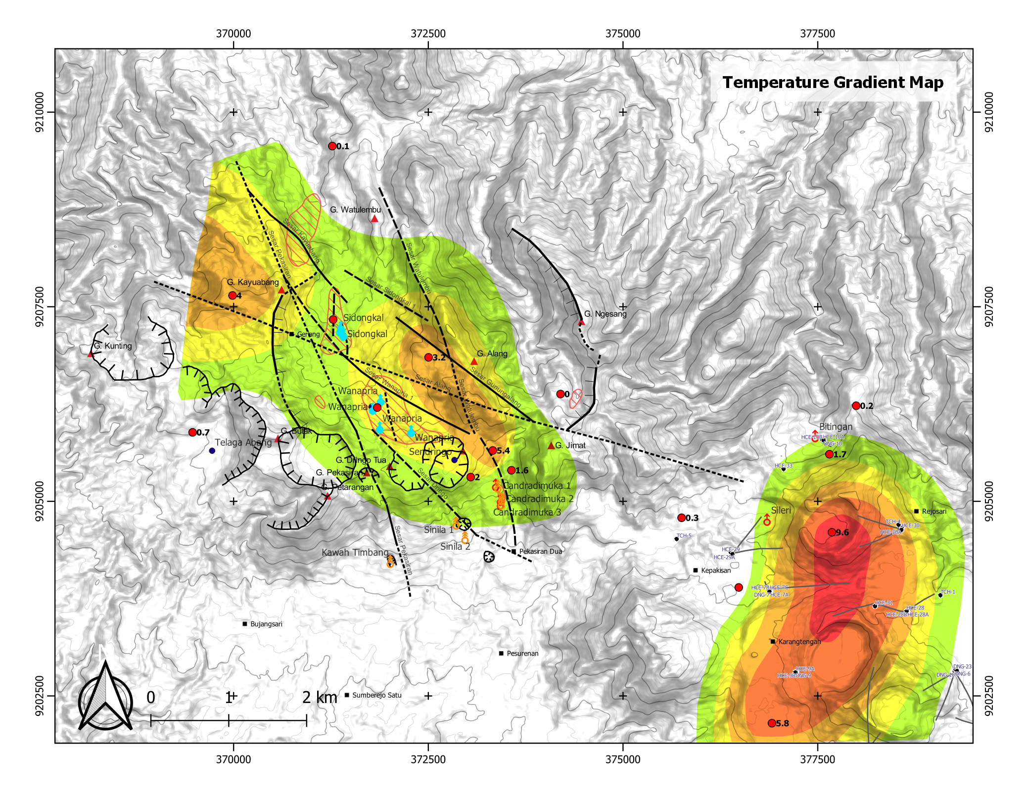
Temperature Gradient Well (Pertamina, 2001)
In 1998, Pertamina conducted the Temperature gradient drilling at Candradimuka and Dieng area
The result shows there is high gradient (orange) well in Candradimuka which coincides with the NW structure of Candradimuka-Watulembu fault.
Corridor NW-Structure
Fault of Candradimuka-Watulembu
High anomaly gradient well
And will be continue to
Candradimuka fumarole area

Slide 20
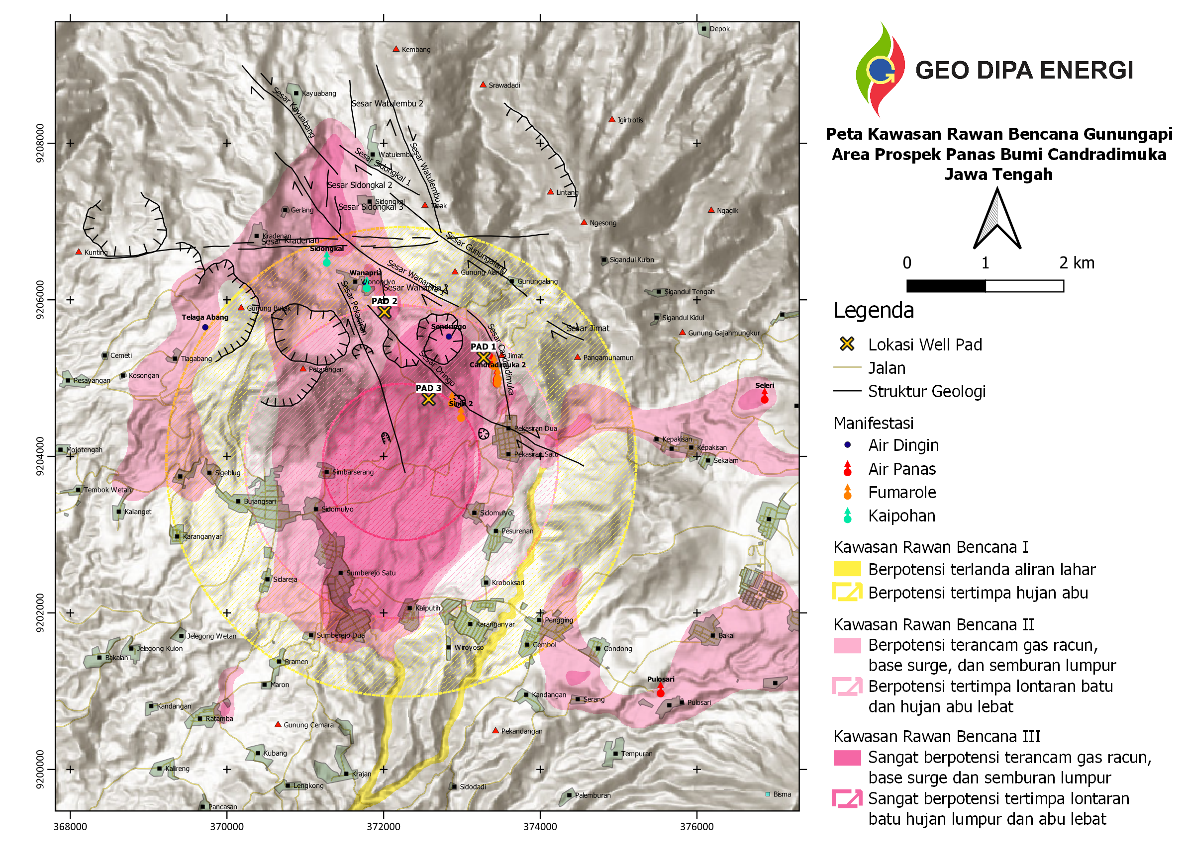
Volcanic and Gas Hazard Risks of Candradimuka Area
The Candradimuka prospect area is planned to drill 3 deep slim hole wells located near the mount Dringo area.
Pad 1 and Pad 2 located in the KRB 2 zone
Pad 3 located in the KRB 3 Zone
According to the hazard-prone area, the exploration activity should be aware to reduce the project risk and fatality.
Sinila Crater
Timbang Crater
Gas Type | Concentration (ppm) |  | Environmentally harmless gas concentration threshold (ppm)
 | Sinila | Timbang
CO | 1 | 2.5 | 5
CO2 | 200000 | 10000 | 10
H2S | 125 | Very low | 0.65
HCN | 20 | 6.5 | 0.05
H3AS | 10 | Very Low | 5000
NO2 | 3.5 | 10 | 5

Slide 21
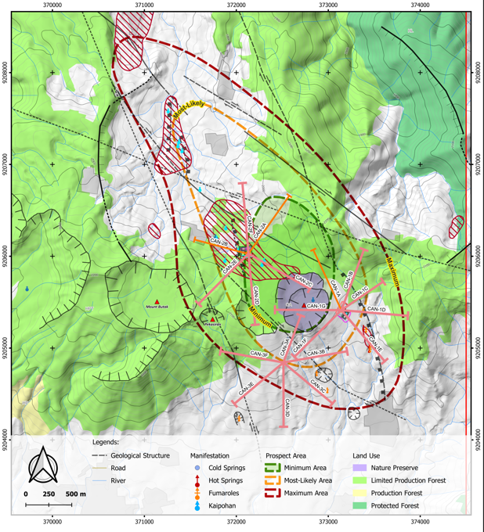
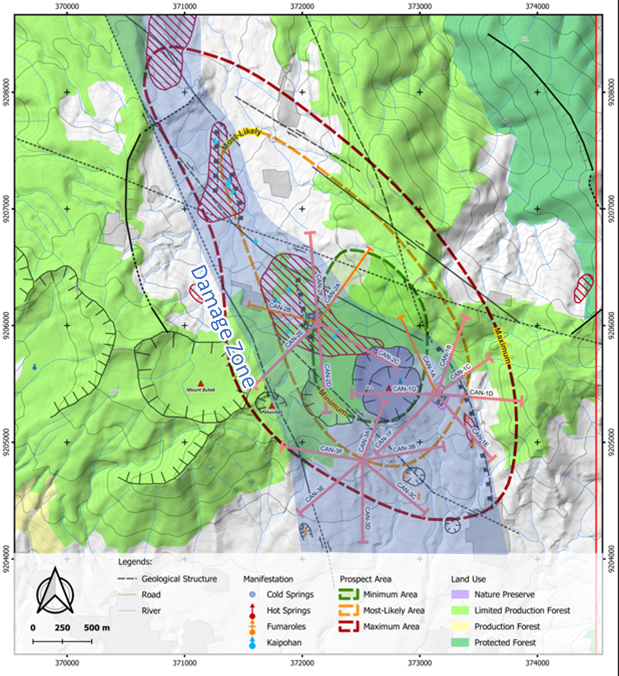

Slide 22
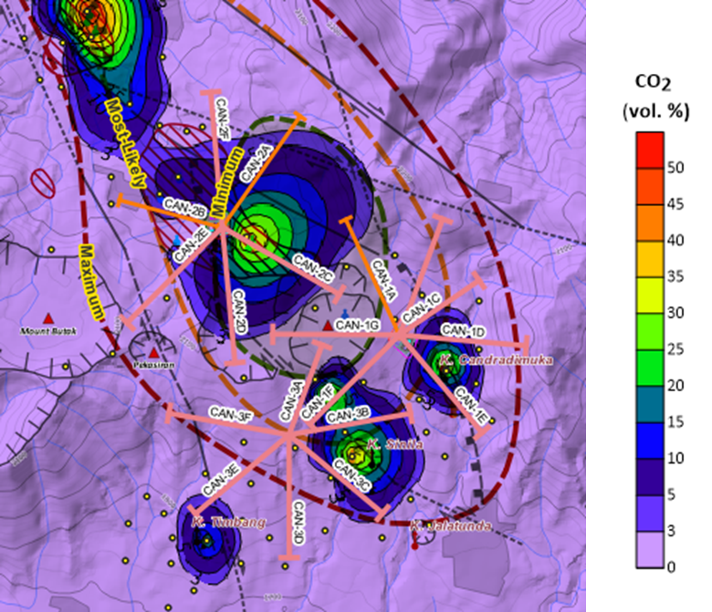
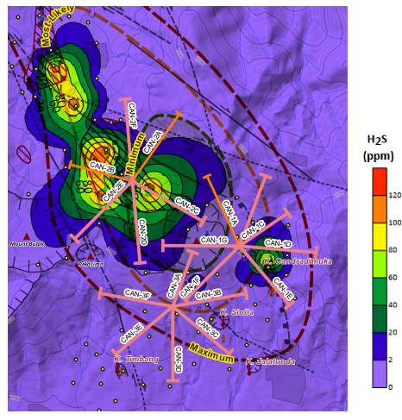

Slide 23
